Slide 1
Mobile-based large 3D Terrain rendering using WebGL (using ‘Grand Canyon’ Terrain Dataset)
Submitted By:-
Subhendra Gautam (IIT2021142)
2. Vishal Kumar (IIT2021196)
3. Chandan Kumar (IIT2021209)
4. Avaneesh Rav Vikram (IIT2021211)
5. Saikat Sadhukhan (IIT2021261)
Guided By:-
Prof. Anupam Gupta Sir
2. Arvind Sir

Slide 2
Content
Result
Future Scope
Conclusion
References
Overview
Activity Time Chart
Introduction
Literature Review
Methodology
Dataset
Language and Libraries Used

Slide 3
Suggestion Given
The Project should mainly focus on mobile phone rendering.
The processing may be done on high-end system, something like Client – Server Model
The project should focus on the dataset named Grand Canyon dataset.

Slide 4
Suggestion Implementation
As suggested, we have successfully achieved the 3D Terrain graphics rendering on mobile phone like devices.
We have implemented the Client – Server architecture as mention in order to render on mobile devices.
We have worked on Grand Canyon dataset as mentioned, that have100 different texture images.
Most of the datasets are paid, so we used Horseshoe Grand Canyon free trial.
Therefore, we have tried to implement all suggestion as per the resources availability.

Slide 5
1.Overview
Our project revolves around the rendering of 3D terrain using WebGL or OpenGL across a variety of devices, with a particular focus on mobile platforms.
1
To demonstrate the capabilities of our implementation, we selected the Grand Canyon dataset as our primary visualization target.
2
In this overview, we will delve into the implementation details, key features, challenges faced, future scope, and concluding remarks of our project.
3

Slide 6
Activity Time Chart
C1
Exploration of different Research Paper, On Terrain Rendering
C2
Rendering on Desktop achieved.
Started working on Mobile Rendering
C3
Successfully achieved mobile rendering.
Testing successful with Grand Canyon Dataset

Slide 7

2. Introduction
Before we get into our topic i.e. 3D Terrain Rendering, let’s us first get familiar with some Terminologies
Terrain
3D Rendering

Slide 8
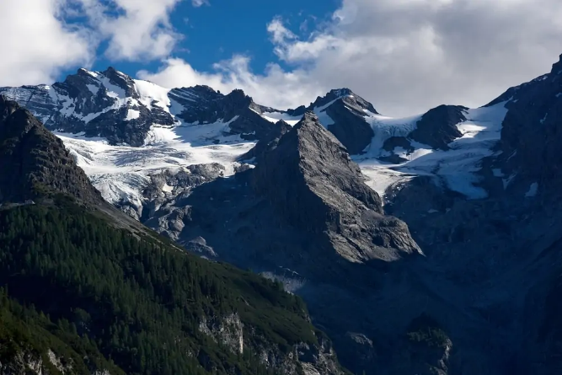
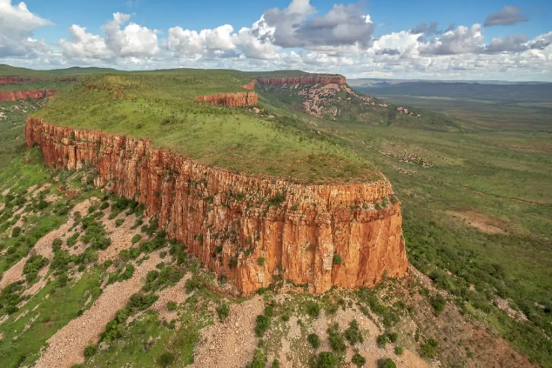
Terrain - An area of the earth’s surface with a distinctive geological character[1]
Topography – Landforms arrangement
Elevation – Height from sea Level
Soil Composition - sandy, loamy, clayey
Vegetation - forests, grasslands, deserts
Hydrology - presence of water bodies, such as rivers, lakes
Climate - temperature, precipitation, and seasonal variations
Mountain
Plateau
Img Source : Outfia

Slide 9

3D Rendering
3D Rendering refers to creating a 2D image or animation (a collection of multiple images played back at a specific frame rate) of a 3D model generated by specialized computer software.
3D Rendering
Virtual Scenes with 3D objects
generating the final animations based on rendering
Setting up Lighting and Material for look realistic
[1]

Slide 10
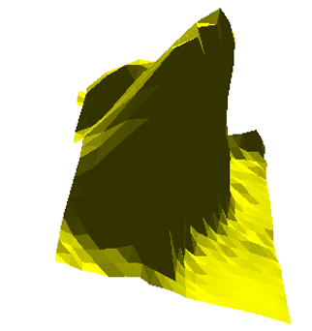
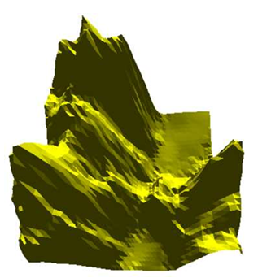
3D Terrain Rendering
Combines 3D rendering techniques with terrain data to create lifelike digital representations of landscapes.
Utilizes heightmap data, mesh generation, textures, and shaders to simulate the geological features of a terrain in a virtual environment.
[1]
a) Terrain
b) Terrain
Img Source : Link

Slide 11
3. Literature Review
1. A review of real-time terrain rendering techniques
Author :- Ming Fan, Min Tang and Jinxiang Dong
Published Date : 08 Nov. 2004
In this paper the authors delve into the realm of real-time terrain rendering techniques, a crucial aspect widely employed in applications such as Virtual Reality, games, flight simulators, and geological visualization programs.
The necessity for rendering terrains at interactive rates has spurred considerable research efforts, resulting in the classification of techniques into two main categories: those based on polygon models and those based on voxel models.[1]

Slide 12
2. Real Time Rendering of Large Terrain on Mobile Devices
Author :- JiangWen, BaoshanZhu , FanWang
Published Year: 2008
This paper introduces a multi-resolution technique for rendering terrains on mobile devices, aiming to reduce complexity and improve speed.
It divides the terrain into tiles and dynamically computes appropriate levels of detail for smooth transitions.
Each tile is rendered adaptively using computed triangle strips, optimizing CPU usage.
The method focuses on an adaptive LOD framework and includes a technique for removing cracks on mesh boundaries.[2]

Slide 13
3. Navigating large terrains using commodity mobile devices
Authors: José M. Noguera, Rafael J. Segura, Carlos J. Ogáyar, Robert Joan-Arinyo
Published Year: 2010
This passage discusses the widespread use of mobile devices for interactive guidance, featuring capabilities like GPS, location-based data access, and terrain rendering.
Real-time terrain rendering is particularly crucial in personal navigation and GIS. However, rendering large terrains in real-time on mobile devices poses challenges due to limitations in computational power, memory, and network bandwidth.
Unlike desktops, mobile devices lack sufficient CPU power and dedicated 3D graphics hardware, making traditional visualization techniques impractical. The limited memory and slow wireless networks further hinder efficient processing of large terrain data on mobile devices.[3]

Slide 14
3.1 Knowledge Gap
Rendering Discrepancies Across Devices: Literature indicates a potential challenge in achieving consistent rendering performance across different devices phone-like devices.
Less Performance for Mobile Platforms: We found a gap in knowledge regarding the performance techniques required to achieve high-quality rendering on mobile platforms with limited resources compared to desktop counterparts.[2]
User Experience Considerations: Understanding the impact of rendering performance on user experience, particularly in mobile contexts where factors like battery consumption and device heating may affect usability.[2]
Cross-platform Compatibility: Addressing challenges related to cross-platform compatibility and ensuring seamless rendering experiences across different operating systems and hardware configurations.[2][3]

Slide 15
4. Methodology
2. Loading 3D Models:
Utilize the GLTFLoader to import 3D models into the scene.
Adjust the scale and position of the models as necessary.[2]
1. Setting Up the Scene:
Define a scene using Three.js.
Initialize a camera to view the scene.
Create a WebGL renderer for rendering 3D graphics.[2]

Slide 16
4. Methodology
4. Keyboard Controls:
Enable keyboard controls for navigating the scene.
Implement movement controls (forward, backward, left, right).
Incorporate zoom in/out functionality.[2]
3. Lighting Setup:
Implement directional lighting to simulate sunlight.
Position the light source to create realistic shadows and highlights.[2]

Slide 17
4. Methodology
5.Touch Controls:
Enable touch controls for mobile devices.
Implement touch-based panning and zooming gestures.
Adjust sensitivity and rotation speed for optimal user experience.[2]
6. Animating the Scene:
Utilize requestAnimationFrame for smooth animation rendering.
Update camera position and rotation based on user input.
Continuously render the scene to provide an interactive experience.[2]

Slide 18
Flowchart
Setting Up the Scene and Rendering 3D Graphics
Setting and defining the scene
Define Scene, Camera, and Renderer
Loading 3D Models
Import Models Using GLTFLoader

Slide 19
Lighting Setup
Implement Directional Lighting
Keyboard Controls
Enable Navigation and Zooming
Touch Controls
Enable Touch-Based Interactions
Animating the Scene
Utilize requestAnimationFrame

Slide 20
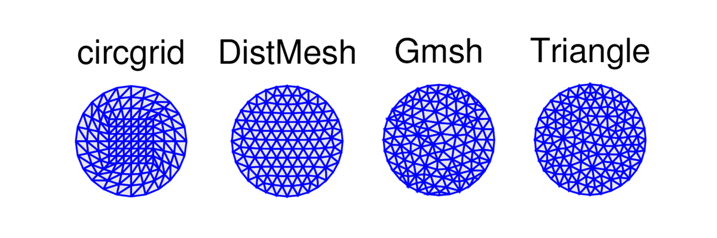
4.1 Using WebGL through Three.Js Library
Geometry and Meshes:
Three.js provides classes for defining geometric shapes such as cubes, spheres, planes, etc., through geometry objects. These geometry objects hold the vertices, edges, and faces of the shapes.
Meshes are created by combining geometries with materials. Materials define how the surface of an object reacts to light.
Textures can be applied to materials to add surface details such as colors, images, or patterns.[3]
We have used quadtree mesh for our project.
Fig.1 Mesh Generation
Source : Paper-2

Slide 21
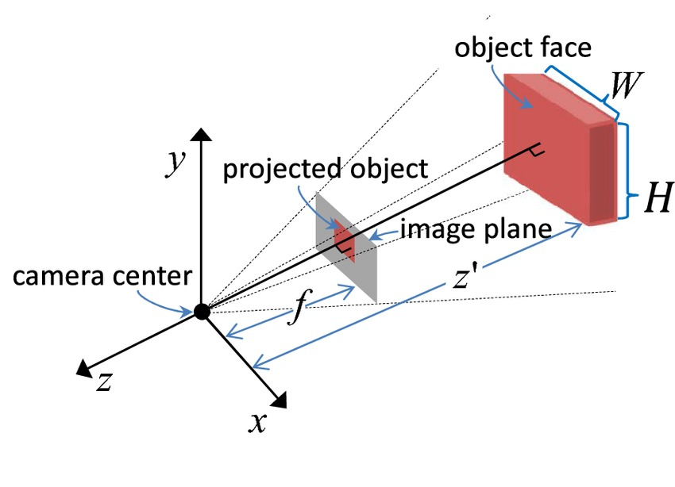
2. Cameras:
Three.js supports different types of cameras.
PerspectiveCamera
OrthographicCamera
CubeCamera.
These cameras define the view of the scene and determine how objects are projected onto the screen.[3]
Fig.2 Perspective Projection
Source : Link

Slide 22
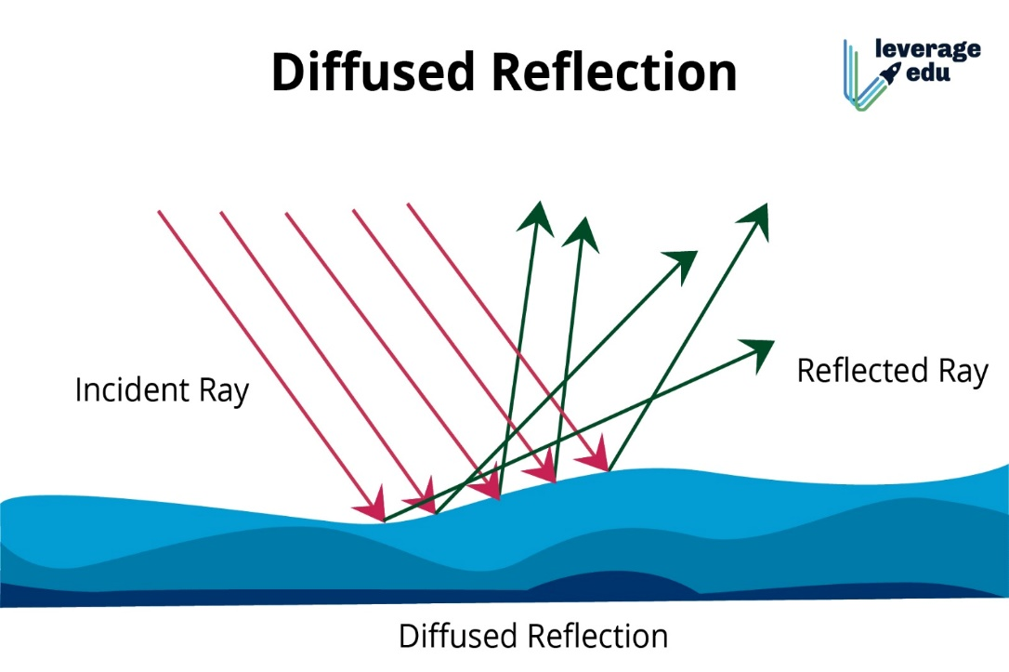
3.Lights:
Lighting in Three.js is implemented using various types of light sources
Ambient Light
Directional Light
Point Light
Spot Light
Hemisphere Light.
These lights illuminate the scene and affect the appearance of objects based on their positions and properties.[3]
Source: Link

Slide 23
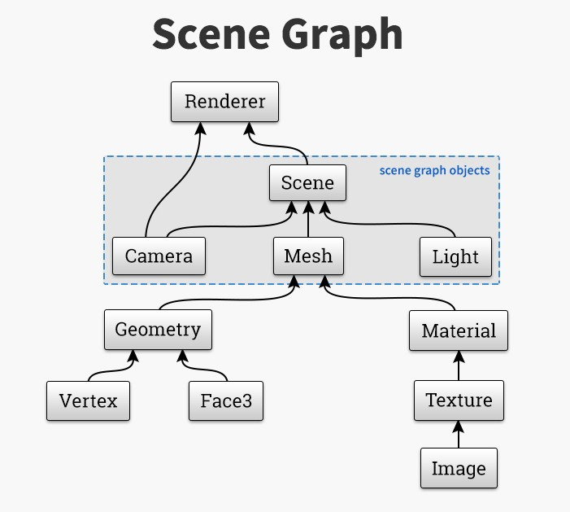
4. Rendering Pipeline:
Three.js abstracts the rendering pipeline, which involves stages like scene setup, culling, projection, rasterization, shading, and compositing.[3]
At each frame, Three.js traverses the scene graph, updates the transformation matrices of objects, performs culling to determine which objects are visible, and then renders the visible objects to the screen using WebGL.[3]
Source: Link

Slide 24
5. WebGL Renderer:
The WebGLRenderer class in Three.js encapsulates the WebGL context and provides methods for rendering the scene onto a canvas element.[3]
It handles the communication between Three.js and the underlying WebGL API, translating Three.js objects and operations into WebGL commands.[3]

Slide 25
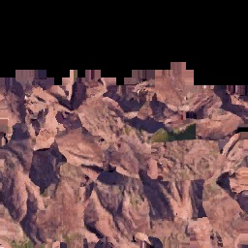
6. Texture Mapping:
Textures in Three.js are created using Texture objects. These textures can be loaded from image files or generated dynamically.
Texture mapping involves applying textures to surfaces of 3D objects to add detail and realism. Three.js provides various mapping techniques such as UV mapping, spherical mapping, and cube mapping.[3]
Fig.5 Sample Texture of GC dataset
Source: Link

Slide 26
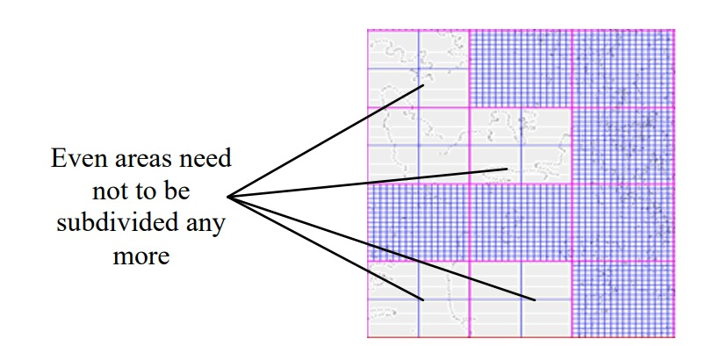
4.2 Quad-Tree Method for Mesh Design in Terrain Rendering
Terrain represented as a quad-tree with each node representing a square region.Top-level node represents the entire terrain area, while child nodes represent subdivisions.[4]
Utilizes quad-tree structure for efficient view frustum culling.Only nodes within the view frustum are traversed and rendered, optimizing rendering performance.[4]
Fig.6 Adaptive subdivision of tiles based on quad-tree
Source : Paper-2

Slide 27
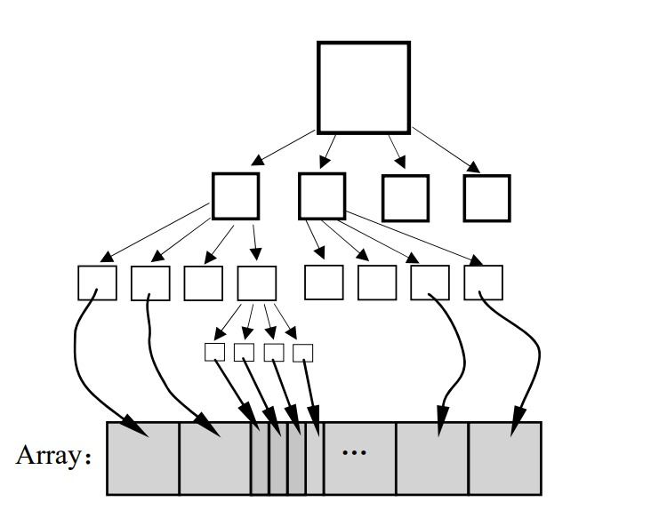
Advantages of Quad-Tree Structure
Provides a flexible and efficient approach to terrain representation.[4]
Enables dynamic adaptation to varying levels of detail and viewing distances.[4]
Optimizes memory usage and rendering performance for real-time applications.[4]
Fig.7 Hierarchy of tile based on quad-tree
Source : Paper-2

Slide 28
5. Dataset
We have used the Grand Canyon Dataset in order to visualize the 3D Terrain rendering.
It contains around 100 different images of textures of grand canyon, which have been taken from different views.
The dataset is freely available on this site.

Slide 29
6. Language and Libraries used
1. Implementation Details:
We utilized WebGL technology for rendering 3D terrain across various devices, with a special emphasis on mobile platforms. In this endeavor, we leveraged Three.js, a popular JavaScript library built on top of WebGL, to streamline the development process and enhance rendering capabilities.
2. Key Components:
WebGL Technology: WebGL served as the foundation for our project, providing a low-level API for rendering interactive 3D graphics within any compatible web browser.
Three.js Integration: We integrated Three.js into our project to simplify complex WebGL operations and abstract away the intricacies of working directly with WebGL. Three.js enabled us to create and manipulate 3D scenes, geometries, materials, and lights with ease, significantly expediting the development process.

Slide 30
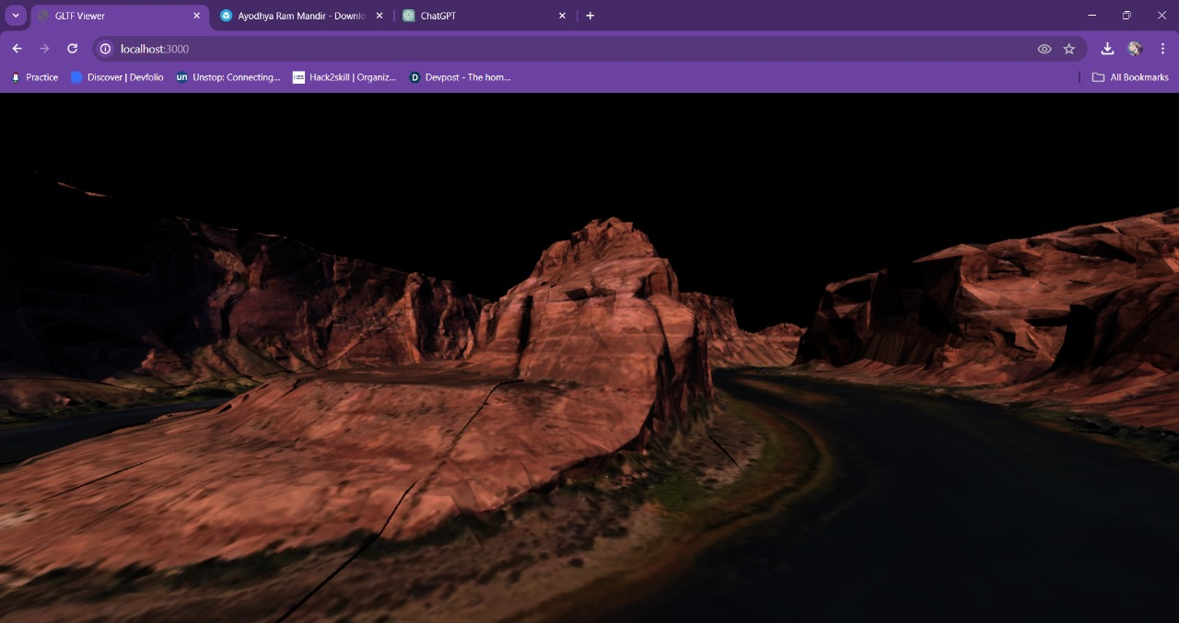
7. Result and Analysis
Laptop View of Horse shoe – Grand Canyon

Slide 31
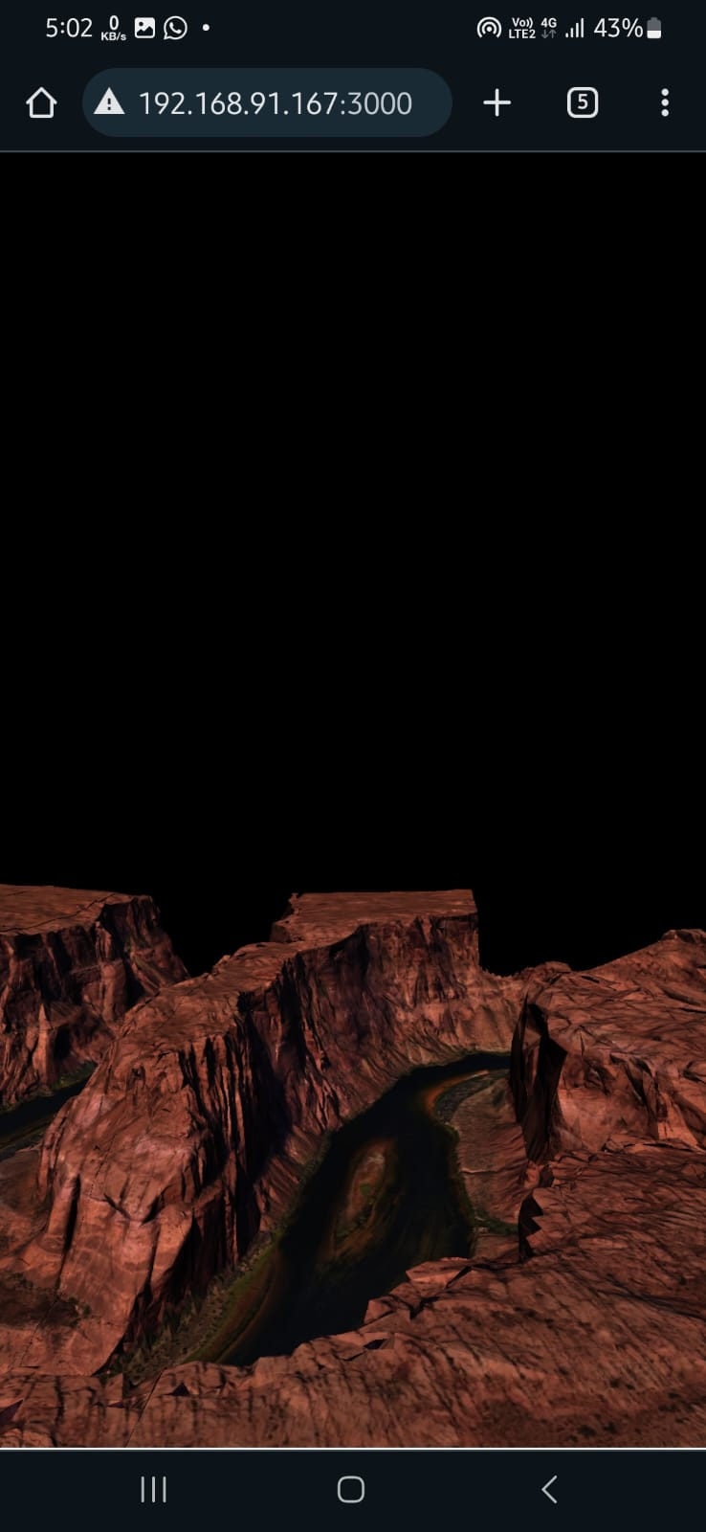
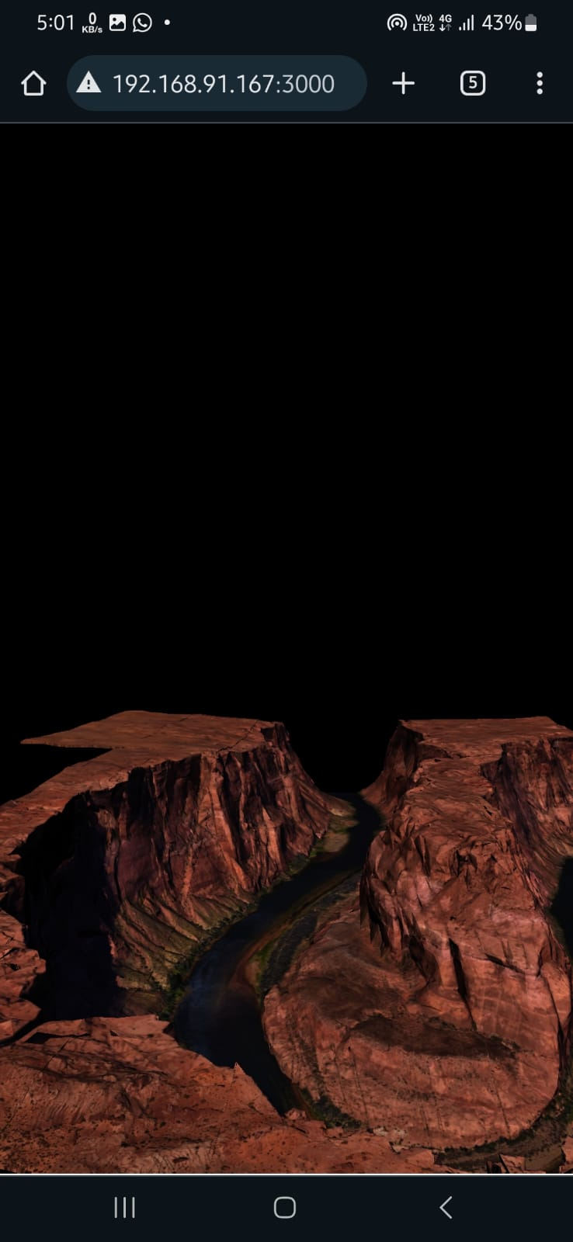
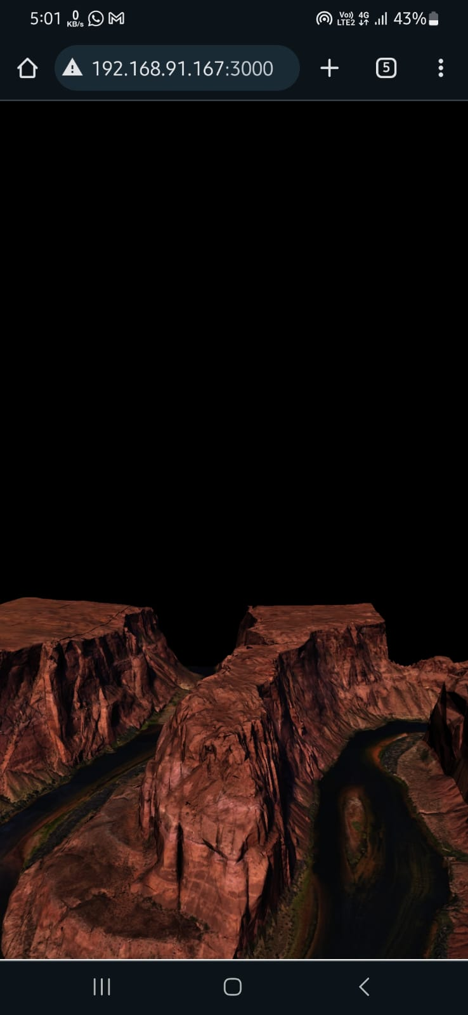
Different Mobile View of Horse shoe – Grand Canyon

Slide 32
Chart depicting work percentage

Slide 33
7.1 Analysis
Initial Focus on Laptop Rendering: Started by prioritizing rendering improvements on laptop devices, achieving high-quality graphics and visual appeal.
Subsequent Shift to Phone-Like Devices: After establishing success on laptops, directed efforts towards improving rendering on phone-like devices, aligning with the primary task of rendering enhancement across different devices.
Successful Achievement of Primary Task: Successfully enhanced rendering on phone-like devices, fulfilling the primary objective of improving rendering capabilities across various devices.

Slide 34
8. Future Scope
1. Further Enhancements: We envision exploring additional features such as lighting effects to enhance the overall user experience.
Touch controls can be made more intuitive.
Control panel for rendering can be provided.
2. Device Optimization: Continuously optimizing performance for a broader range of devices remains a priority for future iterations of our project.
3. User Feedback: Gathering feedback from users will be instrumental in identifying areas for improvement and guiding future development efforts.

Slide 35
9. Conclusion
In summary, our AGA project has been a fruitful journey marked by growth and adaptation.
We've successfully implemented rendering optimizations for mobile devices and incorporated valuable feedback from our professor.
These enhancements underscore our commitment to continuous improvement and innovation. As we conclude this phase, we're eager to apply these learnings in future projects.

Slide 36
10. References
A review of real-time terrain rendering techniques | IEEE Conference Publication | IEEE Xplore​
REAL-TIME RENDERING OF LARGE TERRAIN ON MOBILE DEVICE (isprs.org)
Noguera, J. M., Segura, R. J., Ogáyar, C. J., & Joan-Arinyo, R. (2011, September 1). Navigating large terrains using commodity mobile devices. Computers & Geosciences. https://doi.org/10.1016/j.cageo.2010.08.007
What is 3D Rendering? | Understanding the 3D Visualization Process. (n.d.). https://www.realspace3d.com/resources/what-is-3d-rendering/#Definition​​
Human Verification. (n.d.). https://www.semanticscholar.org/paper/REAL-TIME-RENDERING-OF-LARGE-TERRAIN-ON-MOBILE-BaoshanZhua/a00d6b08f7baaeb13d9cf74a39760a91887c4a70​
Horseshoe bend near Grand Canyon - Download Free 3D model by Ignazio Pillitteri (@gnaz) [0fad26d] (sketchfab.com)
Best 3D Terrain Generation Software (youtube.com)

